Slide 1


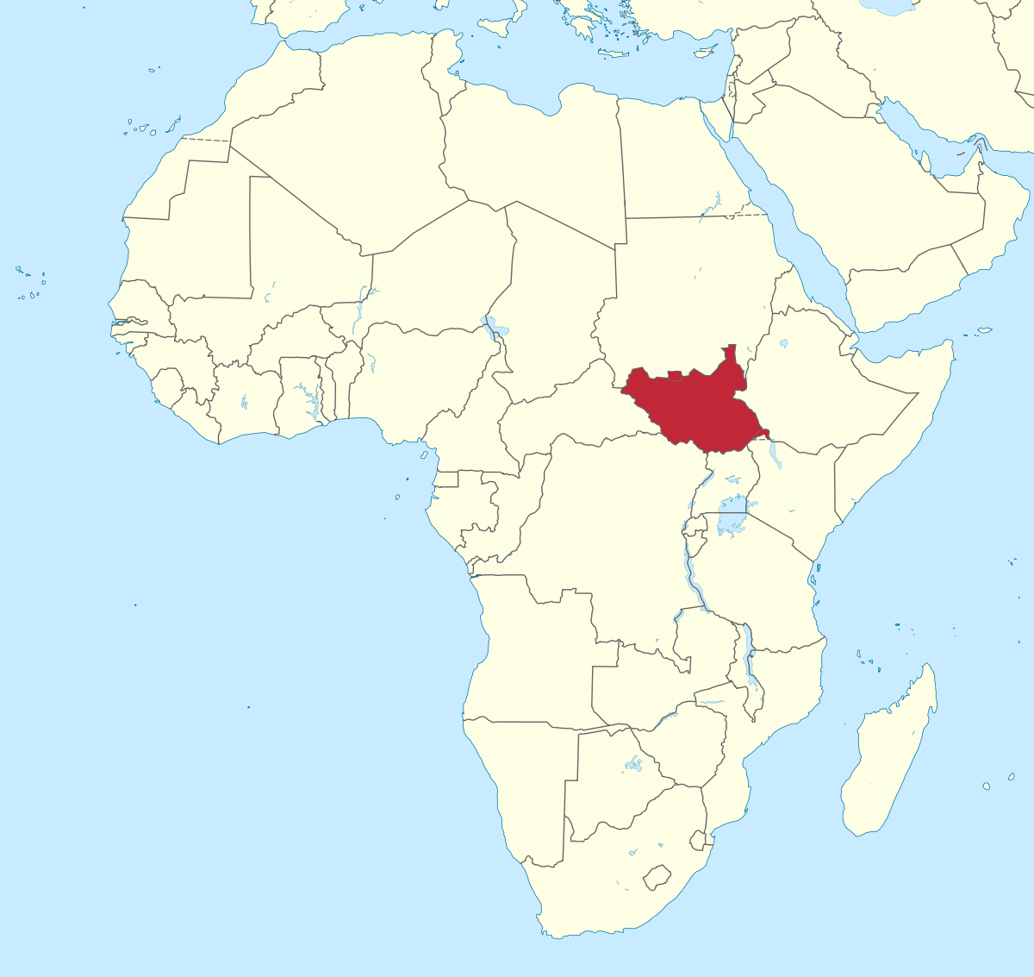
Parenting for Lifelong Health – South Sudan
Campbell McDuling
Bcom Hons Applied Statistics
South Sudan
A scaled-up implementation of Parenting for Lifelong Health

Slide 2
Presentation Overview
Context
Study overview
Data management procedure
Demographic profiles and bias identification
Variable description
Preliminary analysis
Statistical methods
Item reliability analysis
Main results
Specific limitations
General limitations

Slide 3
Why PLH?
Child maltreatment creates significant obstacles to parent and child wellbeing (socially and economically).
Exposes children to crime, poverty, sexually transmitted disease, substance abuse, etc.
Historically high conflict region has resulted in large population of vulnerable adolescents.
Pressing need for intervention in South Sudan’s most vulnerable communities.

Slide 4
Why SUPER?
Points of concern:
No control group
Differing resources
Low-cost infrastructure
Effectiveness of facilitators
Quality of data
PLH effectiveness proven in clinical trials (Cluever et al, 2017; Ward et al, 2020)
Need to evaluate at scale in real-world, low-cost environment
Need to understand obstacles to real world implementation

Slide 5
Study Overview
Research Goal: To test the scalability and effectiveness of PLH in reducing child maltreatment and improving caregiver-child relationships and child well-being in South Sudan.
Who: 290 caregivers with 295 teenagers aged 9 to 19
What: Curriculum presented in weekly group sessions (approx. 15 caregiver-teen pairs) by a trained facilitator.
Guided group discussions
Role-playing activities
Illustrations of positive/negative parenting practices
Home activity assignments
OBJECTIVES:
Assess internal consistency of Likert scales
Identify risk factors at baseline
Quantify changes in Likert scales
Identify obstacles to scalability
DATA
All caregivers and teenagers completed surveys at baseline and follow-up.
These data were analysed to determine if the programme had an impact on harsh discipline, positive parenting, child/caregiver wellbeing.

Slide 6
Data Management
Normalize variable names
Check variables match questionnaires
Check for duplicate observations
Validate variable ranges
Check for missing data
Merge pre and post data
Check for duplicates & missing data
Match caregivers to teens
Reverse code variables
Create composite variables

Slide 7
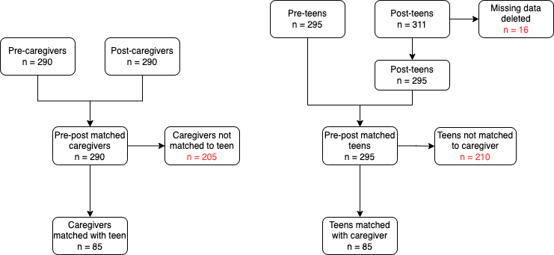
Participant Tracking
Poor matching places importance on identifying bias
Caregiver Data
Adolescent Data

Slide 8
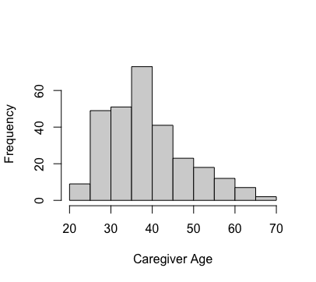
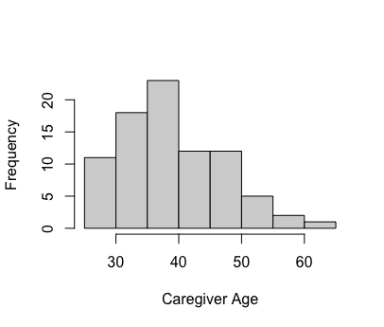
Baseline Demographic Profile – Caregivers
ALL
ALL Caregivers
N = 290
MATCHED Caregivers
N = 85
Mean age approx. 29 years
69% female
85% biological parent
51% father lives in HH
72% mother lives in HH
27% father deceased
15% mother deceased
96% ran out of money for monthly essentials
37% have unwell adult in HH
19% have unwell child in HH
13% have disabled child in HH
Mean age approx. 39 years
79% female
91% biological parent
51% father lives in HH
74% mother lives in HH
31% father deceased
15% mother deceased
93% ran out of money for monthly essentials
39% have unwell adult in HH
21% have unwell child in HH
13% have disabled child in HH
MATCHED

Slide 9
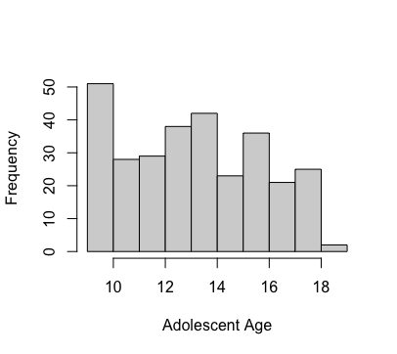
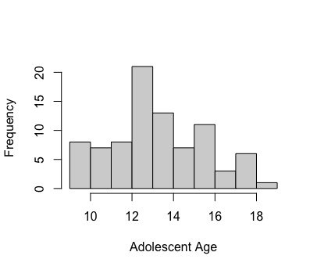
Baseline Demographic Profile – Adolescents
ALL Teens
N = 290
MATCHED Teens
N = 85
ALL
Mean age 13.6 years
51% female
11% have children of their own
88% enrolled in school
91% cannot read at all or can with much difficulty
Only 3% can read easily
53% report substance abuse in HH
44% report physical or verbal arguments
Mean age 13.7 years
60% female
11% have children of their own
94% enrolled in school
91% cannot read at all or can with much difficulty
44% report substance abuse in HH
44% report physical or verbal arguments
MATCHED

Slide 10
Baseline Demographic Profile – Adolescents
ALL Teens
N = 290
MATCHED Teens
N = 85

Slide 11

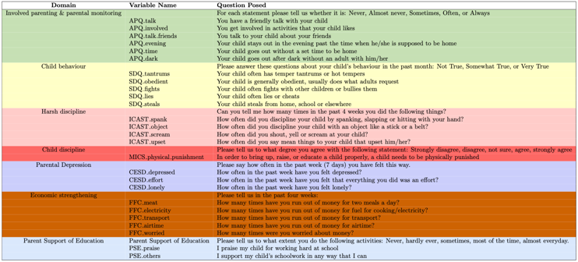
Caregiver Outcome Measures
= reverse code

Slide 12
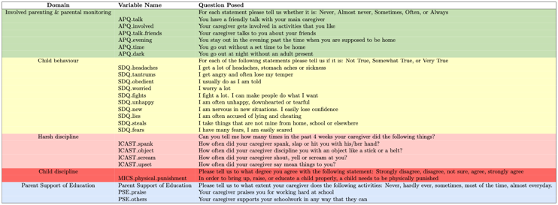
Adolescent Outcome Measures
= reverse code

Slide 13
Preliminary Analysis – Caregivers (ALL)
Lack of variation is concerning

Slide 14
Preliminary Analysis – Caregivers (ALL)
Lack of variation at baseline??

Slide 15
Preliminary Analysis – Adolescents (ALL)
Lack of variation is concerning

Slide 16
Preliminary Analysis – Attitudes to Physical Punishment
“In order to bring up, raise, or educate a child properly, a child needs to be physically punished”
Caregivers
Adolescents

Slide 17
Composite Scores – Caregivers (ALL)

Slide 18
Composite Scores – Caregivers (ALL)

Slide 19
Composite Scores – Adolescents (ALL)

Slide 20
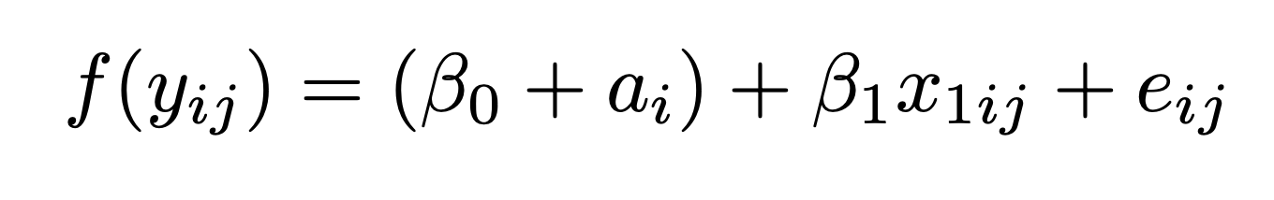
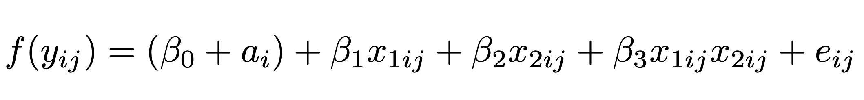
Statistical Methods
Item reliability analysis
Assess internal consistency of Likert scales (CFA and Cronbach’s alpha)
Assess risk factors for baseline scales
Mixed effect models
Ordinal mixed effect models
Model repeated measurements, incorporate within-subject correlation
Generalised linear models
Model changes in scales as response
Model those items within scales where internal consistency cannot be validated
Assess impact of moderators
Assess impact of program/time

Slide 21
Item Reliability Analysis – Caregivers PRE
Assessing internal consistency of variables
Domain | Items | Cronbach’s Alpha | Interpretation
APQ | 6 | 0.545 | Poor
SDQ | 5 | 0.292 | Unacceptable
ICAST | 4 | 0.133 | Unacceptable
CESD | 3 | NA | Test not applicable (no variation in sample)
FFC | 5 | -0.052 | Unacceptable (close to no variation in sample)
PSE | 2 | NA | Test not applicable (too few items)

Slide 22
Item Reliability Analysis – Adolescents PRE
Assessing internal consistency of variables
Domain | Items | Cronbach’s Alpha [95% CI] | Interpretation
APQ | 6 | 0.341 | Poor
SDQ | 5 | 0.612 | Questionable
ICAST | 4 | 0.902 | Excellent
PSE | 2 | NA | Test not applicable (too few items)

Slide 23
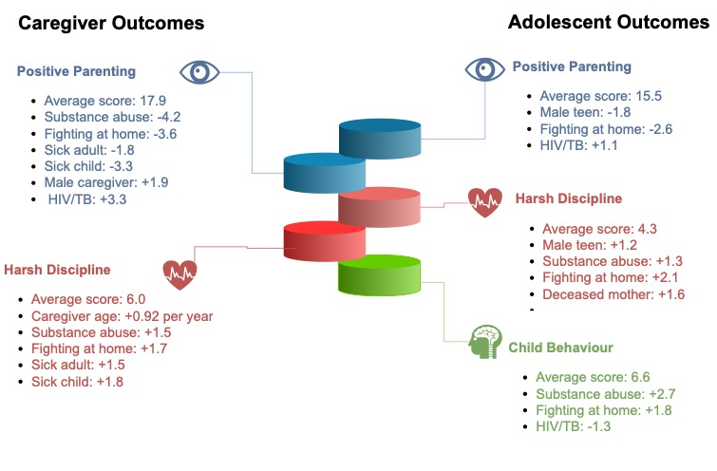
Key Model Results – Baseline Scores
Identifying risk factors at baseline

Slide 24
Key Model Results – Mixed Effect Models
Matched Caregivers
N = 85
Scale | Baseline average (S.E) | Time effect (S.E.) | Assumed distribution | Model fit
Positive Parenting | 17.9 (0.28) | +5.4 (0.34) | Gaussian | Poor
Child Behaviour | 2.5 (0.13) | -1.5 (0.16) | Gaussian | Poor
Harsh Discipline | 5.9 (0.05) | <0.00001 (infnty) | Poisson | Unacceptable
Parental Stress & Depression | 8.0 (0.05) | -3.0 (0.06) | Gaussian | Unacceptable
Financial Family Coping | 12.0 (0.12) | -5.9 (0.13) | Gaussian | Unacceptable
Main moderators
Stronger time effect for:
Substance abuse
Fighting at home
HH with sick child
Weaker effect for:
HIV/TB
Male caregivers

Slide 25
Model Validation

Slide 26
Key Model Results – Mixed Effect Models
Main moderators
Matched Teens
N = 85
Stronger time effect for:
Fighting at home
Male teens
Older teens
Weaker effect for:
Male caregivers
HIV/TB
Father doesn’t live at home
Scale | Baseline average (S.E) | Time effect (S.E) | Assumed distribution | Model fit
Positive Parenting | 15.6 (0.24) | +7.5 (0.26) | Gaussian | Reasonable
Child Behaviour | 6.6 (0.25) | -6.4 (0.32) | Gaussian | Poor
Harsh Discipline | 3.0 (1.12) | <0.00001 (infnty) | Poisson | Poor

Slide 27
Model Validation

Slide 28
Key Model Results – Modeling Differences

Slide 29
Key Model Results – Item Ordinal Regression Models

Slide 30
Data Problems in Scaled-up Studies
Unique identifiers for purpose of analysis
Not all teens have associated caregiver
Few items per domain of interest
Unidentifiable variable naming
Mixed up data capturing (entries not matching columns)
Trustworthiness of data
Breaks in chain of communication
Some issues are study design related
Most are data capturing issues

Slide 31
References
Cluver, L. D., et al. 2017. Parenting for Lifelong Health: a pragmatic cluster randomised controlled trial of a non-commercialised parenting programme for adolescents and their families in South Africa. BMJ Global Health. doi:10.1136/bmjgh-2017-000539
Ward, C. L. 2020. Parenting for Lifelong Health for Young Children: a randomized controlled trial of a parenting program in South Africa to prevent harsh parenting and child conduct problems. Journal of Child Psychology and Psychiatry 61:4. John Wiley & Sons. doi:10.1111/jcpp.13129

Slide 32


Thank you. Questions and suggestions welcomed.

